Slide 1
Lymphoproliferative Disorders
Professor of the Department internal diseases
Liskova Yu.V.

Slide 2
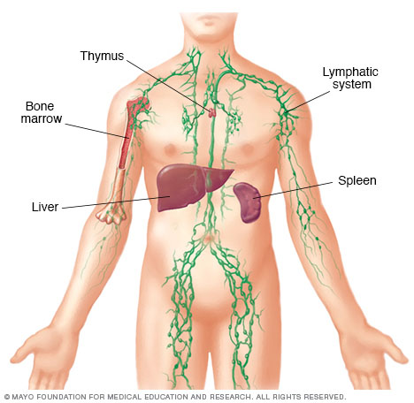
Function of the Lymph System

Slide 3
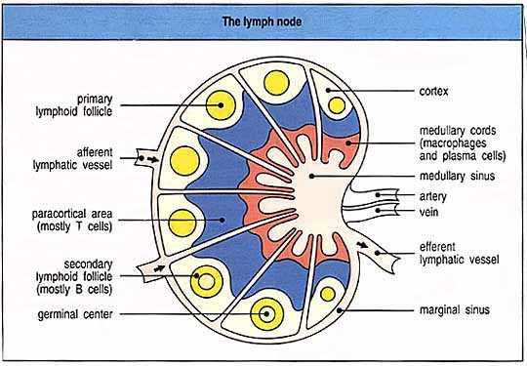
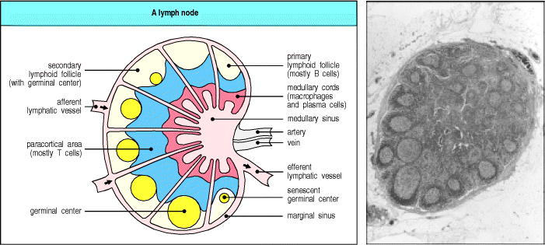
Lymph Node

Slide 4
Lymphocytes
B-cells develop in the bone marrow and influence the immune system by helping cells recognize infection.
T-cells develop and mature in the thymus gland. Killer T-cells destroy viruses and cancers. Helper T-cells orchestrate an immune response.
NK (natural killer) cells destroy viruses and cancers.
Notes:
The definition of cancer is the uncontrolled growth of abnormal cells.
Lymphoma is a cancer that affects lymphocytes. Lymphoma can start in any part of the lymphatic system. Like normal lymphocytes, cancerous lymphocytes can travel through the blood and lymphatic system and spread and grow in many parts of the body, including the lymph nodes, spleen, bone marrow, and other organs.
B-cells have become cancerous in 85% of patients diagnosed with NHL.
T cells are also responsible for immune responses that lead to:
- Rejection of a transplanted organ
- Virtually all autoimmune disease (diabetes, multiple sclerosis, rheumatoid arthritis etc.)
- Some allergic reactions (gluten intolerance etc.)

Slide 5
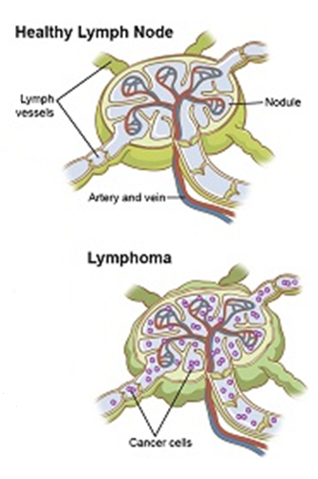
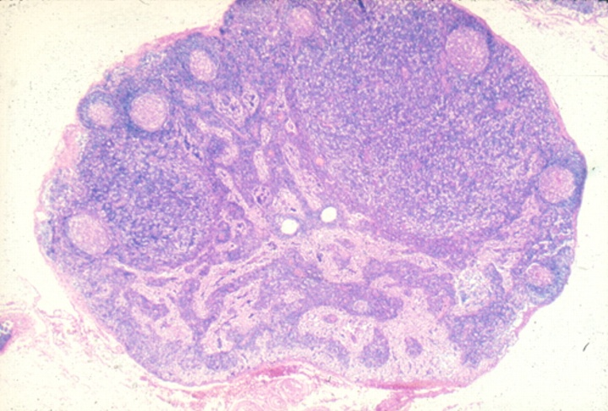
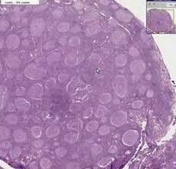

Slide 6
Increasing age is a risk factor for Non-Hodgkin Lymphoma (NHL)
Notes:
Caucasian males, ages 60-80, are at highest risk

Slide 7
Lymphomas can present with many different clinical manifestations.
Variable
    Severity: asymptomatic to extremely ill
    Time course: evolution over weeks, months, or years
Systemic manifestations
    fever, night sweats, weight loss, anorexia, pruritis
Local manifestations
    lymphadenopathy, splenomegaly most common
    any tissue potentially can be infiltrated
Notes:
Less than 20% of patients have general symptoms at onset

Slide 8
Lymphomas don’t just arise in lymph nodes
Nodal Sites Extranodal
neck GI tract (stomach)
supraclavicular bone marrow
axillary liver
groin skin
(spleen) head and neck
bone

Slide 9
Other Complications of Lymphoma
Bone marrow failure (infiltration)
Central nervous system infiltration
Immune hemolysis or thrombocytopenia
Compression of structures (eg spinal cord, ureters) by bulky disease
Pleural/pericardial effusions, ascites

Slide 10
Diagnosis of Lymphoma
History:
  Unwell
  Lumps/bumps
  Short of breath, abdominal pain/symptoms
  B symptoms:
    Fever
    Drenching Night Sweats
    Weight loss (>10% of baseline weight)

Slide 11
Lymphoma Types
Lymphoma
Hodgkin
1,ooo patients diagnosed each year
Relative 5-year survival 85%
Leading cancer age 15-29
Non-Hodgkin
8,200 new cases NHL each year
Relative 5-year survival 66% but varies greatly by subtype
Chronic lymphocytic leukemia
2,200 patients diagnosed this year
7-10 year survival for most
Notes:
Lymphoma is 5th most common cancer diagnosis in Canada. Can occur at any age but most 50+.
NHL is approximately 8 times more common than HL – 85% of all lymphomas are NHL. NHL is group of at least 60 related cancers.
The main difference between HL and NHL is the presence of Reed-Sternberg cells, detected when the tumour is examined under a microscope. A Reed-Sternberg cell is only present in Hodgkin lymphoma.
Diagnosis every 45 minutes
100,000 people affected by lymphoma in Canada

Slide 12
Distinguishing lymphomas by clinical behaviour
Indolent NHL or CLL
  Slow growth
  Often asymptomatic
  Long natural history possible
  Incurable with standard therapy
Aggressive NHL or HL
  Rapid growth
  Often symptomatic
  Fatal in months (if untreated)
  Potential for cure with standard therapy
Notes:
for simplicity, we often divide lymphomas into whether they are growing and behaving aggressively or slowly……
Aggressive lymphomas are characterized by v. rapid tumour growth, patients generally present with symptoms…and if this disease is left completely untreated, it can be fatal in months…
By contrast….indolent lymphomas are characterized by slow tumour growth…..pts are often asympt….and the natural history of the disease can be measured in many many years……..
One major characteristic that also distinguishes these types of lymphomas is that our standard cancer therapies that attack rapidly dividing cells…have the potential to cure the aggressive NHLs …. …whereas the indolent NHLs are considered incurable with standard therapies…

Slide 13
Current Lymphoma Classification
WHO – 2016 Revision
There are over 60 types of lymphoma.
Hodgkin lymphoma
  Classical Hodgkin lymphomas (4)
  Nodular lymphocyte predominant Hodgkin lymphoma (1)
Mature B-cell neoplasms (41 types)
Mature T-cell & NK-cell neoplasms (27 types)

Slide 14
Hodgkin lymphoma
Classical Hodgkin lymphoma
Nodular sclerosis classical Hodgkin lymphoma
Lymphocyte-rich classical Hodgkin lymphoma
Mixed cellularity classical Hodgkin lymphoma
Lymphocyte-depleted classical Hodgkin lymphoma
Non-classical Hodgkin Lymphoma
Nodular lymphocyte-predominant Hodgkin lymphoma (low grade watch and wait)

Slide 15
Non Hodgkin B Cell
Chronic lymphocytic leukemia/small lymphocytic lymphoma
Monoclonal B-cell lymphocytosis*
B-cell prolymphocytic leukemia
Splenic marginal zone lymphoma
Hairy cell leukemia
  Splenic B-cell lymphoma/leukemia, unclassifiable
  Splenic diffuse red pulp small B-cell lymphoma
  Hairy cell leukemia-variant
Lymphoplasmacytic lymphoma
  Waldenström macroglobulinemia
Monoclonal gammopathy of undetermined significance (MGUS), IgM*
μ heavy-chain disease
γ heavy-chain disease
α heavy-chain disease
Monoclonal gammopathy of undetermined significance (MGUS), IgG/A*
Plasma cell myeloma
Solitary plasmacytoma of bone
Extraosseous plasmacytoma
Monoclonal immunoglobulin deposition diseases*
Extranodal marginal zone lymphoma of mucosa-associated lymphoid tissue (MALT lymphoma)
Nodal marginal zone lymphoma
  Pediatric nodal marginal zone lymphoma
Follicular lymphoma
  In situ follicular neoplasia*
  Duodenal-type follicular lymphoma*
Pediatric-type follicular lymphoma*
Large B-cell lymphoma with IRF4 rearrangement*
Primary cutaneous follicle center lymphoma
Mantle cell lymphoma
In situ mantle cell neoplasia*
Diffuse large B-cell lymphoma (DLBCL), NOS
Germinal center B-cell type*
Activated B-cell type*
T-cell/histiocyte-rich large B-cell lymphoma
Primary DLBCL of the central nervous system (CNS)
Primary cutaneous DLBCL, leg type
EBV+ DLBCL, NOS*
EBV+ mucocutaneous ulcer*
DLBCL associated with chronic inflammation
Lymphomatoid granulomatosis
Primary mediastinal (thymic) large B-cell lymphoma
Intravascular large B-cell lymphoma
ALK+ large B-cell lymphoma
Plasmablastic lymphoma
Primary effusion lymphoma
HHV8+ DLBCL, NOS*
Burkitt lymphoma
Burkitt-like lymphoma with 11q aberration*
High-grade B-cell lymphoma, with MYC and BCL2 and/or BCL6 rearrangements*
High-grade B-cell lymphoma, NOS*
B-cell lymphoma, unclassifiable, with features intermediate between DLBCL and classical Hodgkin lymphoma
Notes:
85% of NHL types are B-cell

Slide 16
Non Hodgkin T Cell
T-cell prolymphocytic leukemia
T-cell large granular lymphocytic leukemia
Chronic lymphoproliferative disorder of NK cells
Aggressive NK-cell leukemia
Systemic EBV+ T-cell lymphoma of childhood*
Hydroa vacciniforme–like lymphoproliferative disorder*
Adult T-cell leukemia/lymphoma
Extranodal NK-/T-cell lymphoma, nasal type
Enteropathy-associated T-cell lymphoma
Monomorphic epitheliotropic intestinal T-cell lymphoma*
Indolent T-cell lymphoproliferative disorder of the GI tract*
Hepatosplenic T-cell lymphoma
Subcutaneous panniculitis-like T-cell lymphoma
Mycosis fungoides
Sézary syndrome
Primary cutaneous CD30+ T-cell lymphoproliferative disorders
  Lymphomatoid papulosis
  Primary cutaneous anaplastic large cell lymphoma
Primary cutaneous γδ T-cell lymphoma
Primary cutaneous CD8+ aggressive epidermotropic cytotoxic T-cell lymphoma
Primary cutaneous acral CD8+ T-cell lymphoma*
Primary cutaneous CD4+ small/medium T-cell lymphoproliferative disorder*
Peripheral T-cell lymphoma, NOS
Angioimmunoblastic T-cell lymphoma
Follicular T-cell lymphoma*
Nodal peripheral T-cell lymphoma with TFH phenotype*
Anaplastic large-cell lymphoma, ALK+
Anaplastic large-cell lymphoma, ALK−*
Breast implant–associated anaplastic large-cell lymphoma*

Slide 17
Current Lymphoma Classification
Notes:
Diffuse Large B-Cell Lymphoma

Slide 18
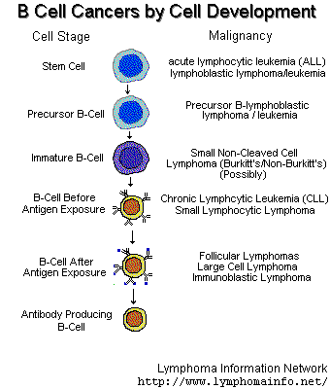
The different lymphomas originate at different levels of lymphocyte maturation.

Slide 19
Lymphoma: How do we figure out what type you have?
Physical Exam
  Cardiac, respiratory, abdominal,
  Lymph nodes
Biopsy
  FNA
  Incisional biopsy
  Excisional biopsy
Laboratory:
  CBC and differential
  LDH (prognostic marker in NHL)
  ESR (important in HD)
  Bone marrow aspirate/biopsy
Imaging:
  Chest X-ray
  Ultrasound
  CT scan neck/ chest/ abdomen/pelvis
  Gallium Scan
  PET
Other:
  LP – if CNS symptoms, or in certain high risk cases of aggressive lymphoma (sinus, testicle, bone marrow)

Slide 20
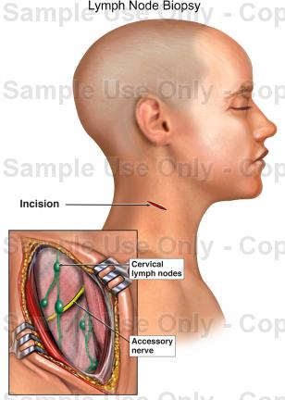
Pathology remains the absolute most critical piece of the diagnostic work-up….

Slide 21
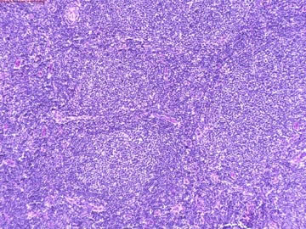
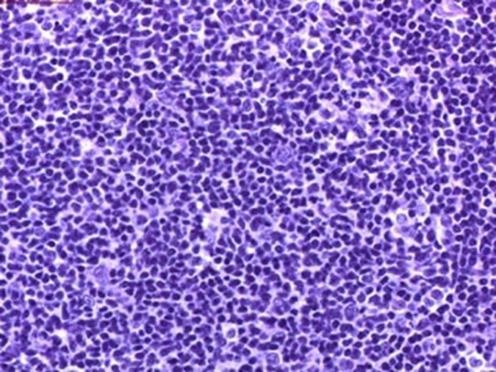
Biopsies are Examined to Classify the Lymphoma
Notes:
Eg of follicular lymphoma

Slide 22
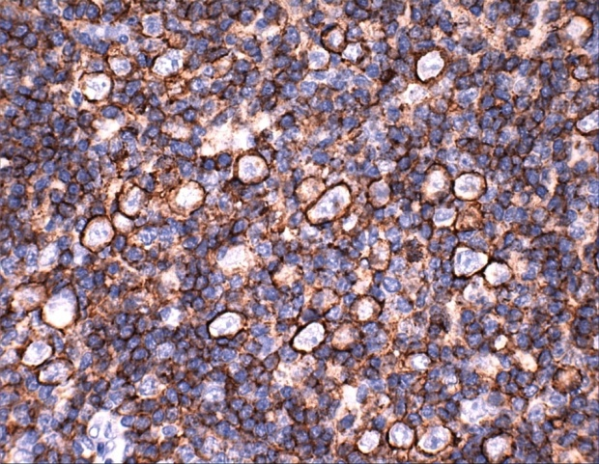
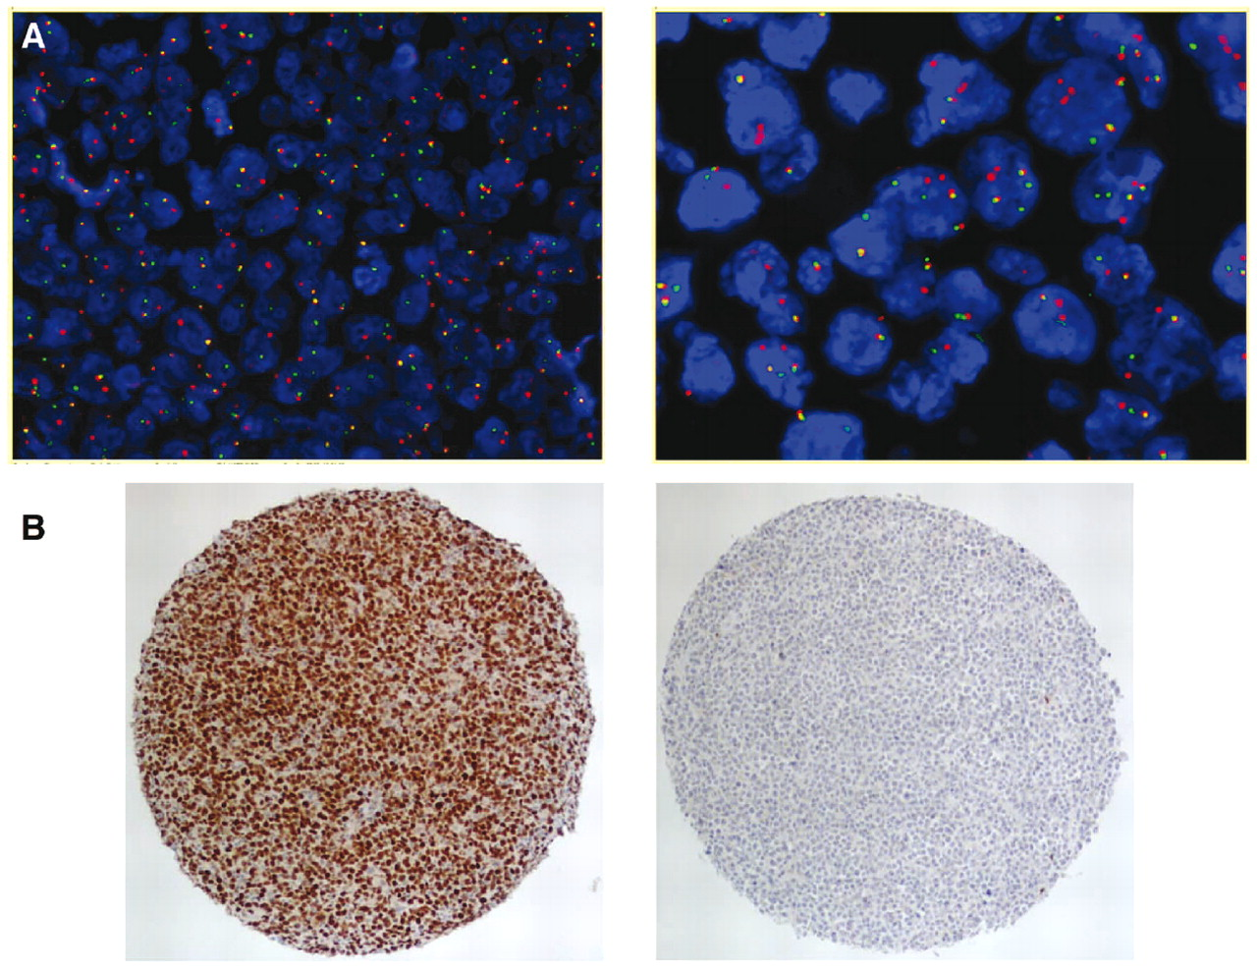
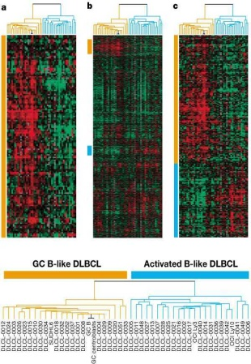
Lymphoma Classification
Morphology
Immunohistochemistry
Cytogenetics
(gene expression profiling)

Slide 23
Staging of Lymphoma and CLL
Stage might influence prognosis
Stage might influence how we choose to treat
But…we DO NOT USE the term “metastatic”

Slide 24
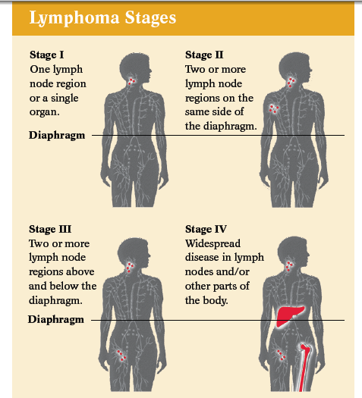
"A" means that you have no “B” symptoms
"B" reported fever, night sweats, & weight loss = ‘B’ symptoms
"E" parts of your body other than the lymph nodes are involved
Notes:
Staging
- Can help us determine the extent of lymphoma in the body
Can tell us anatomically where the lymphoma is located
Can forewarn us of any organ injury that might arise from the lymphoma
When and what treatment is needed…

Slide 25
CLL Staging – Rai Staging System
Rai stage | Risk | lymphocytes | RBC | Platelets | Lymph nodes enlarged? | Spleen enlarged?
0 | low | high | normal | normal | no | no
1 | intermediate | high | normal | normal | yes | no
2 | intermediate | high | normal | normal | maybe | yes
3 | high | high | low | normal | maybe | maybe
4 | high | high | low | low | maybe | maybe

Slide 26
With all of the information we are now able to formulate a treatment plan and discuss prognosis.
Initial Evaluation:
Specific Histologic Sub-type
Extent of disease
General health status of patient
Treatment Plan
Prognosis

Slide 27
Many lymphoma subtypes with different treatments and different outcomes.
It is important you know exactly what your diagnosis is.
If you don’t know, ask your doctor.
Notes:
Staging
- Can help us determine the extent of lymphoma in the body
Can tell us anatomically where the lymphoma is located
Can forewarn us of any organ injury that might arise from the lymphoma
When and what treatment is needed…

Slide 28
Know Your Subtype
Is it Hodgkin or Non Hodgkin?
  If it is Hodgkin, is it Classic or not?
  If it is Non Hodgkin, is it T-cell or B-cell
    If it is T-cell, is it Skin (Cutaneous) or Body (Systemic)
    If it is B-cell, is it Indolent or Aggressive

Slide 29
Treating lymphomas according to subtype
Indolent NHL or CLL
  Slow growth
  Often asymptomatic
  Long natural history possible
  Incurable with standard therapy
Watch and Wait if no symptoms
Goal of treatment intitially is to get long remission without too many side effects
More difficult to treat each time it comes back
Goal of later treatment is to control disease symptoms
Notes:
for simplicity, we often divide lymphomas into whether they are growing and behaving aggressively or slowly……
Aggressive lymphomas are characterized by v. rapid tumour growth, patients generally present with symptoms…and if this disease is left completely untreated, it can be fatal in months…
By contrast….indolent lymphomas are characterized by slow tumour growth…..pts are often asympt….and the natural history of the disease can be measured in many many years……..
One major characteristic that also distinguishes these types of lymphomas is that our standard cancer therapies that attack rapidly dividing cells…have the potential to cure the aggressive NHLs …. …whereas the indolent NHLs are considered incurable with standard therapies…

Slide 30
Treating lymphomas according to subtype
  Treat right away
  Goal of initial treatment is to try to cure
  More toxic treatments may be necessary
  Not everyone will be cured
Aggressive NHL or HL
  Rapid growth
  Often symptomatic
  Fatal in months (if untreated)
  Potential for cure with standard therapy
Notes:
for simplicity, we often divide lymphomas into whether they are growing and behaving aggressively or slowly……
Aggressive lymphomas are characterized by v. rapid tumour growth, patients generally present with symptoms…and if this disease is left completely untreated, it can be fatal in months…
By contrast….indolent lymphomas are characterized by slow tumour growth…..pts are often asympt….and the natural history of the disease can be measured in many many years……..
One major characteristic that also distinguishes these types of lymphomas is that our standard cancer therapies that attack rapidly dividing cells…have the potential to cure the aggressive NHLs …. …whereas the indolent NHLs are considered incurable with standard therapies…

Slide 31
Definition
Lymphoproliferative disorders are a heterogeneous group of malignant clonal proliferations of lymphocytes
Classified as sub-types of non-Hodgkin’s lymphoma
B-, T- and NK-cell lineages

Slide 32
CD (claster differentiation) antigenes of B-cells
Pluripotent stem cell – only CD-34, is absent on pre-B-lymph-s
CD-10 – the earliest В-cell AG. Is present on blasts
CD-11a – hairy В-cells
CD-19 CD-20 CD-22 – precursors of В-cells
CD-38 CD-85 – plasma cells antigenes

Slide 33
CD (claster differentiation) antigenes of T-cells
CD-7 – the earliest
CD-3 CD-5 CD-2 – mature cells (thymus)
CD-4 → T-helper
CD-8 → T-supressor
CD-57 CD-16 → NK

Slide 34
B-cells maturing stages
AG-non-depended
AG-dependent
In bone marrow
Under influence of interleukins
In lymphatic organs (spleen, lymph. nodes, tonsils)
Under AG-stimulation, with T-cells

Slide 35
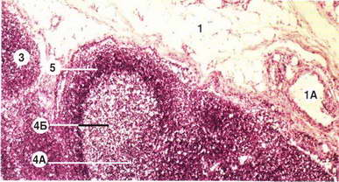
1– lymph. node
3 – herminative center– dark zone: centrocytes– AG selection
4A – herminative center– light zone: centroblasts – reproduction of selected B-cells
4Б– mantle zone: immunoblasts – processing of
memory cells and plasma cells
5 – marginal zone: mature В-cells

Slide 36
Classifications
1832 - Thomas Hodgkin: first description of lymphoma
1966 – Rappaport
1973 – BNLI
1974 – Like/Lennert
1974 – Lukes/Collins
1976 – WHO
1982 – Working Formulation
1994 – REAL
2001 – WHO, updated 2008

Slide 37
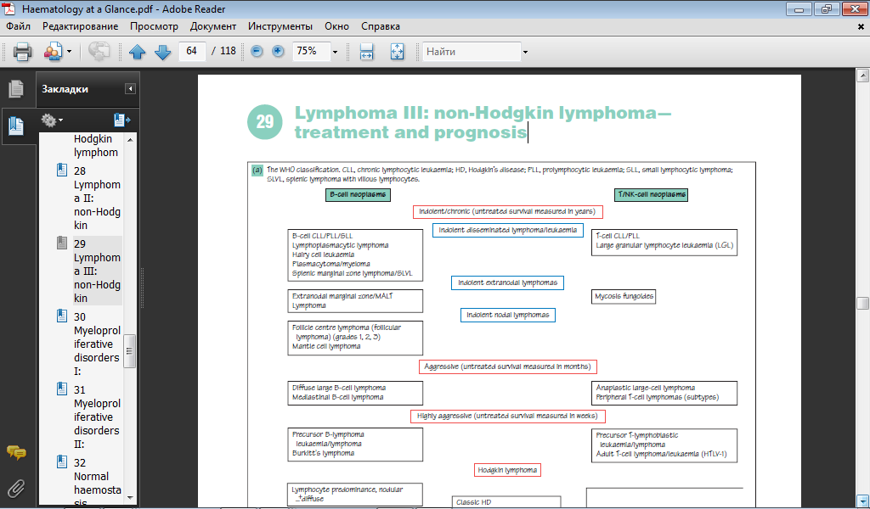

Slide 38
Etiology
Requires a number of distinct transforming events to occur within the affected cells
Risk factors are
  Altered immunity
    Inherited syndromes
      ataxia telangiectasia
      Wiskott - Aldrich syndrome
      common variable immunodeficiency
    Immunodeficiency due to past medical history
      long-term immunosuppressive drug therapy, transplant recipients
      patients with autoimmune diseases
  Infections (HIV, HTLV-1, HHV8, EBV, H. pylori)
  Occupational links: herbicides, pesticides, Petrochemical industry, asbestos
  exposed workers, nickel refinery workers
  Lifestyles and other exposures: Ionizing radiation, Little conclusive evidence as
  regards dietary factors and electromagnetic fields

Slide 39
Clinical Features
Annual incidence is approximately 10/100,000
Elderly (median 65 year) M:F ratio 2:1
Chronic B-cell lymphoproliferative disorders account for more than 90% of lymphoid malignancies
T-cell and NK-cell neoplasm being relatively uncommon

Slide 40
Clinical presentations and natural histories of chronic lymphoproliferative disorders are extremely heterogeneous
Many patients are asymptomatic at the time of first presentation, with the diagnosis being made as an incidental finding after a routine medical examination or blood test, for example, CBC

Slide 41
Patients may present with lymphadenopathy, systemic symptoms such as weight loss, night sweats and fever or the symptoms of anemia and thrombocytopenia
Enlargement of the spleen and, less frequently, the liver
Hyper viscosity symptoms
Definitive diagnosis is made on the characteristic lymphocyte morphology and immunophenotype usually from samples of peripheral blood or lymph nodes

Slide 42
Lymphocytosis
Lymphocytosis is defined as an absolute lymphocyte count exceeding 4 x 10⁹/liter (4000/ul)
Monoclonal lymphocytosis
  lymphoproliferative disease (because of an intrinsic defect in the expanded lymphocyte population)
Polyclonal lymphocytosis ( secondary to stimulation or reaction to factors extrinsic to lymphocytes, generally infections and/or inflammation)

Slide 43
Characterization of cell surface markers is valuable in distinguishing primary lymphocytosis (leukemic) from secondary lymphocytosis
Analysis for immunoglobulin or T cell receptor gene rearrangement also may provide evidence for monoclonal B cell or T cell proliferation, respectively

Slide 44
The blood film of patients with lymphocytosis

Slide 45
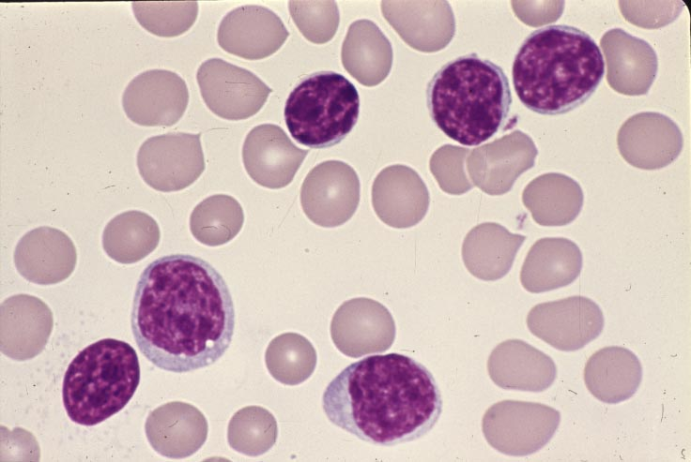
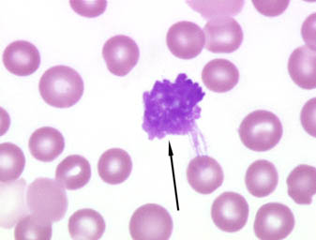
Peripheral smear
Small lymphocytes with clump chromatin scant cytoplasm + smudge cells =CLL

Slide 46
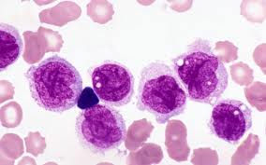
Atypical CLL-less condensed chromatin and irregular nuclei

Slide 47
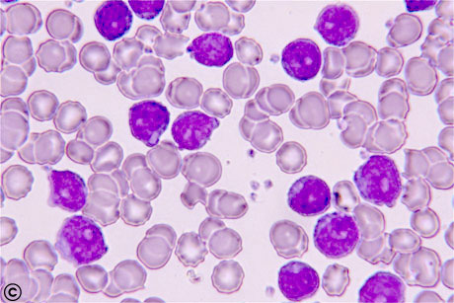
Medium size cells, round nucleus, moderately condensed chromatin, prominent central nucleoli, scant basophilic cytoplasm – prolymphocytic leukemia

Slide 48
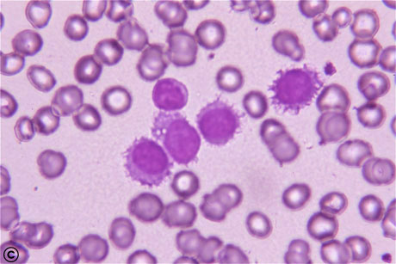
Small to medium size cell, oval to indented nuclei, slightly less clumped chromatin, abundant cytoplasm, circumferential hairy projections
Hairy cell leukemia

Slide 49
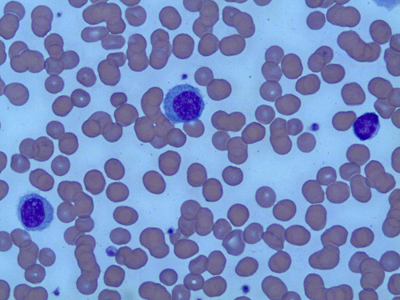
Mature B lymphocytes with pale cytoplasm, irregular cytoplasmic borders, and polar villous projections-SMZL

Slide 50
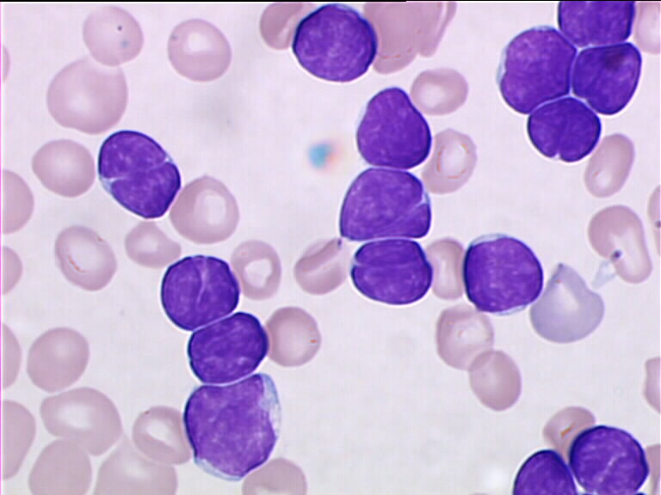
Scant cytoplasm some cell shows clefting – follicular lymphoma

Slide 51
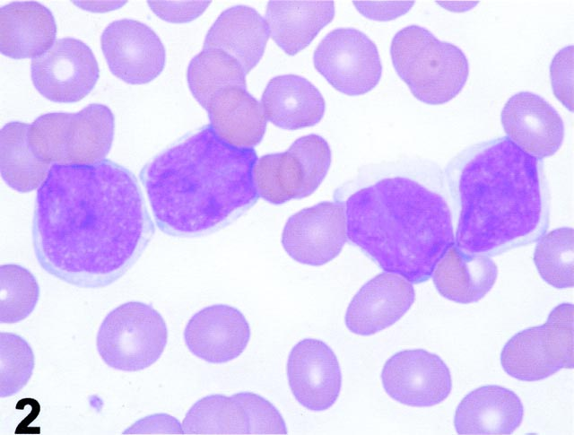
Small to medium size cells slightly irregular nuclear contour - like mantle cell lymphoma

Slide 52
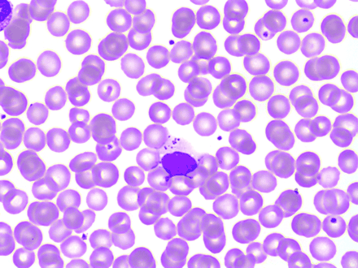
Large granulocyte - T cell large granular leukemia/lymphoma

Slide 53
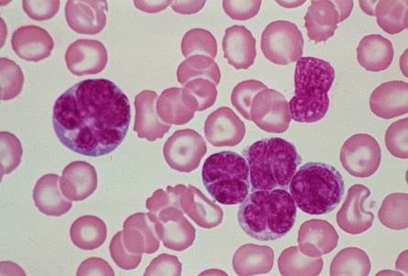
Large lymphoid cells irregular nuclei, basophilic cytoplasm (flower cells)-adult T cell leukemia/lymphoma

Slide 54
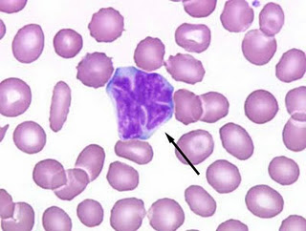
Large lymphocytes with ceribriform nuclei and scant cytoplasm-sezary syndrome

Slide 55
Ancillary diagnostic studies
Use of immunologic/molecular techniques
Malignant lymphomas reproduce the immunobiology of their benign counterparts
This reproduction may be aberrant, and hence distinguishable from normal
Expression, normal and aberrant can be used to:
  Determine lineage, B versus T versus NK
  Detect clonality
  Suspect malignancy- loss or aberrant expression of expected antigens
  Recognize characteristic patterns of antigenic expression associated with certain subtypes of lymphoma

Slide 56
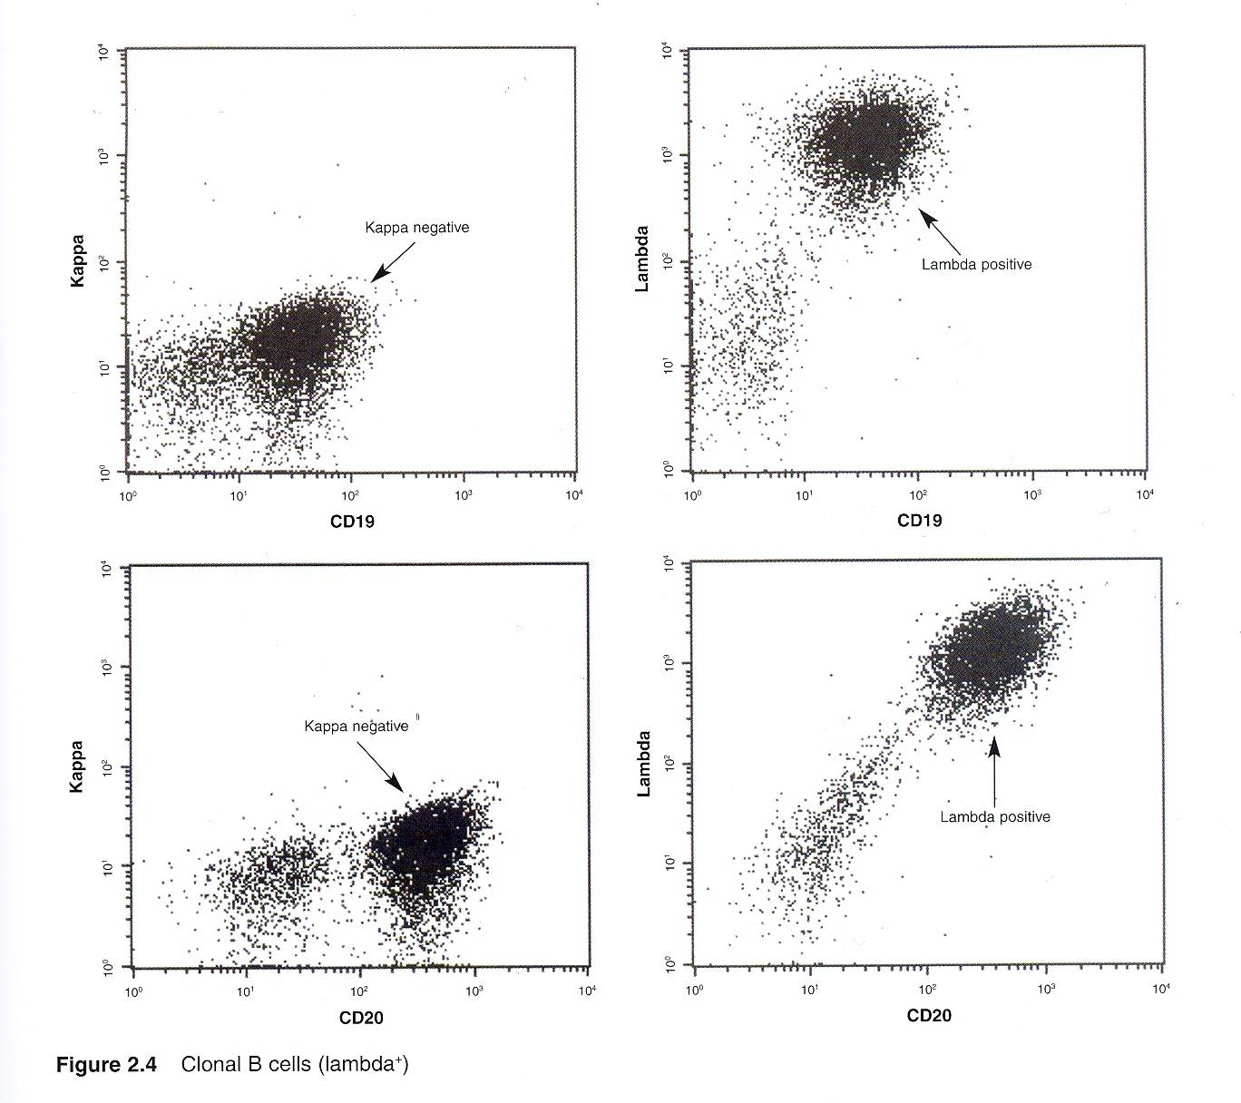

Slide 57
Normal lymphoid maturation
Requires two major activities
  The production of a unique antigenic receptor on it's surface
  The expression of several surface proteins necessary for antigen recognition, cell
  activation, cell-cell communication.
Antigen receptors are generated through the process of "genetic
rearrangement"- the random selection and then juxtaposition of discontinuous
genetic segments encoding the antigen receptor genes
  B cells
    Immunoglobulin receptor composed of two heavy chains and two light chains
      Select specific heavy chain gene sequences
      Select only one of two light chains, kappa or lambda
  T cells
    Select one of two heterodimeric receptors
      Alpha/Beta heterodimer T cell receptor
      Gamma/Delta heterodimer T cell receptor

Slide 58
Surface antigen production
Immune cells require numerous surface molecules for effective immune response, cell-cell communication and regulation
Classified into B cell associated, T cell associated, activation associated, cytokine receptors
Expression occurs in an orderly sequence in lymphoid maturation
Antibodies to these molecules cataloged through the CD - clusters of differentiation - numerical system.

Slide 59
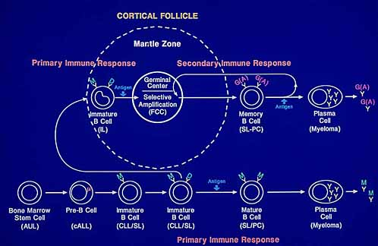
Lymphomas frozen at various stages of antigen dependent B cell maturation and differentiation

Slide 60
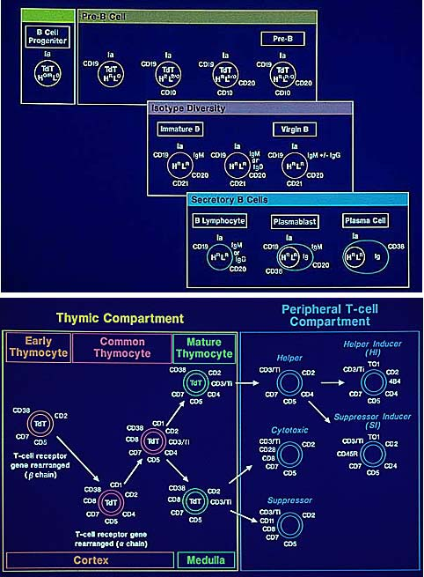
T cell antigen expression

Slide 61
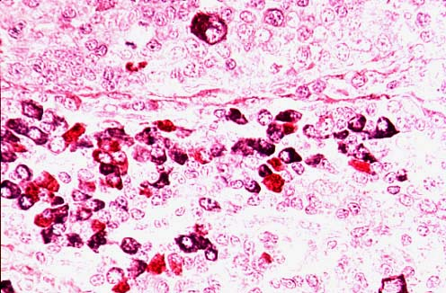
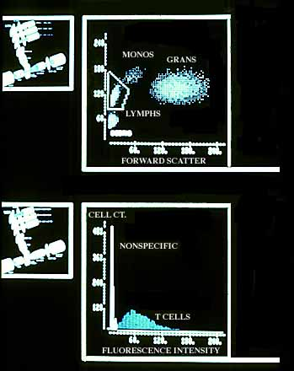
Immunologic Techniques
Flow cytometry
Immunohistochemistry
Both utilize monoclonal antibodies to detect clonality and unique antigenic patterns

Slide 62
B cell lymphoma

Slide 63
Definition
Mature B cell neoplasms are clonal tumors of mature B cells at various stages of maturation
They recapitulate normal stages of maturation.

Slide 64
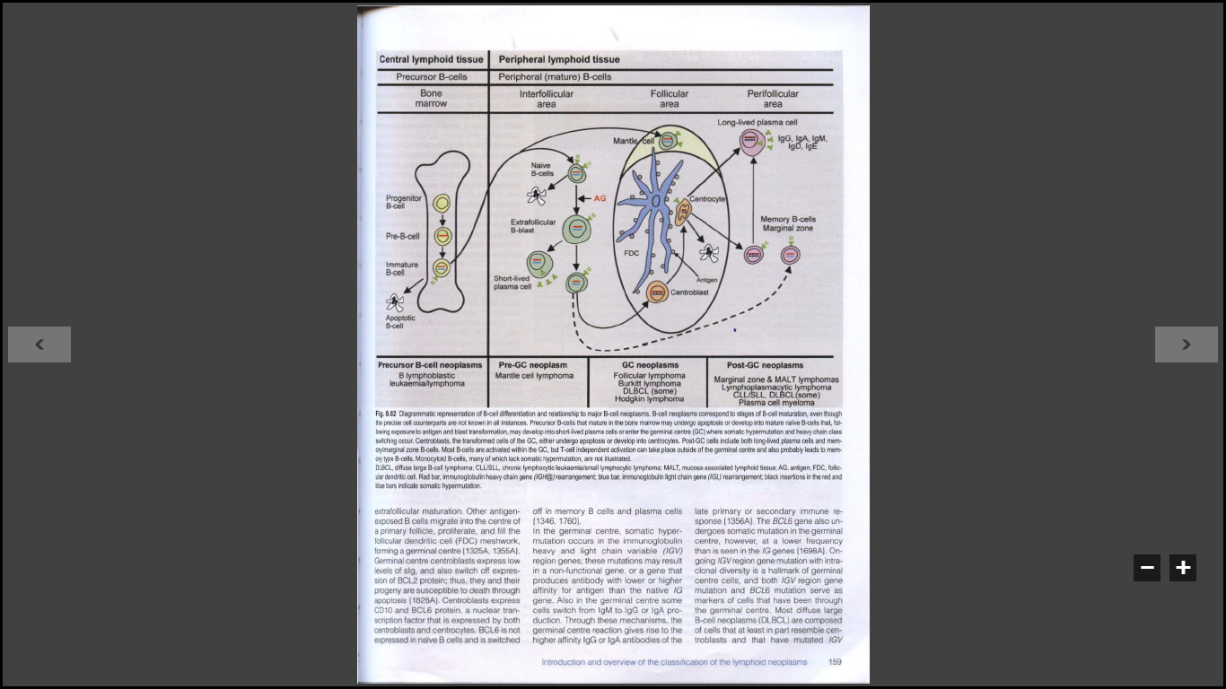
B cell Development

Slide 65
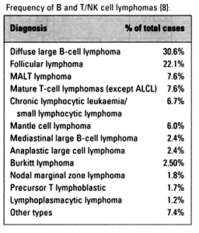

Slide 66
Indolent versus aggressive
Indolent
  Small lymphocytic lymphoma/CLL
  Follicular lymphoma, Grades 1/2
  Extranodal Marginal zone lymphoma of MALT type
  Nodal marginal zone lymphoma
  Splenic marginal zone lymphoma
  Hairy cell leukemia
  Lymphoplasmacytic lymphoma
  Plasma cell myeloma
  Plasmacytoma
  Cutaneous T cell lymphoma
  Cutaneous CD30+ anaplastic large cell lymphoma
Aggressive
  Prolymphocytic leukemia
  Large B cell lymphoma
  Burkitt lymphoma
  Mantle cell lymphoma
  Anaplastic large cell lymphoma
  All peripheral T cell lymphomas

Slide 67
Clinical Characteristics of Patients
Disease | Median Age, years | Frequency in Children | % Male | Stage I/II vs III/IV, % | B Symptoms, % | Bone Marrow Involvement, % | % Surviving 5 years
CLL/SLL | 65 | Rare | 53 | 9 vs 91 | 33 | 72 | 51
Mantle cell lymphoma | 63 | Rare | 74 | 20 vs 80 | 28 | 64 | 27
Splenic marginal zone B cell lymphoma | 60 | Rare | 48 | 67 vs 33 | 19 | 14 | 74
Follicular lymphoma | 59 | Rare | 42 | 33 vs 67 | 28 | 42 | 72
Hairy cell leukemia | 50 | Rare | 80 | 21vs 79 | 25 | 100 | 90

Slide 68
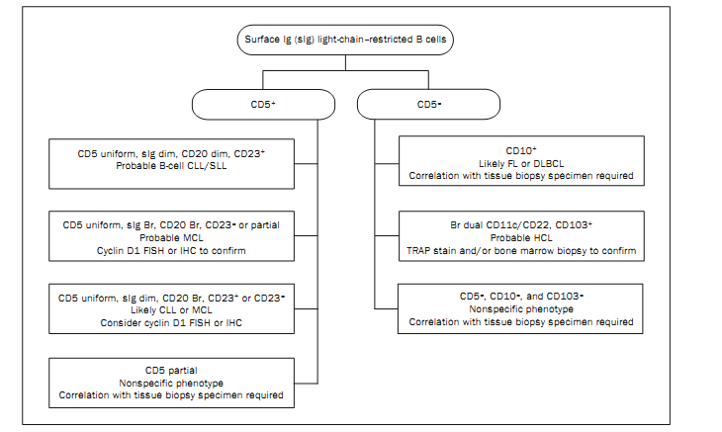

Slide 69
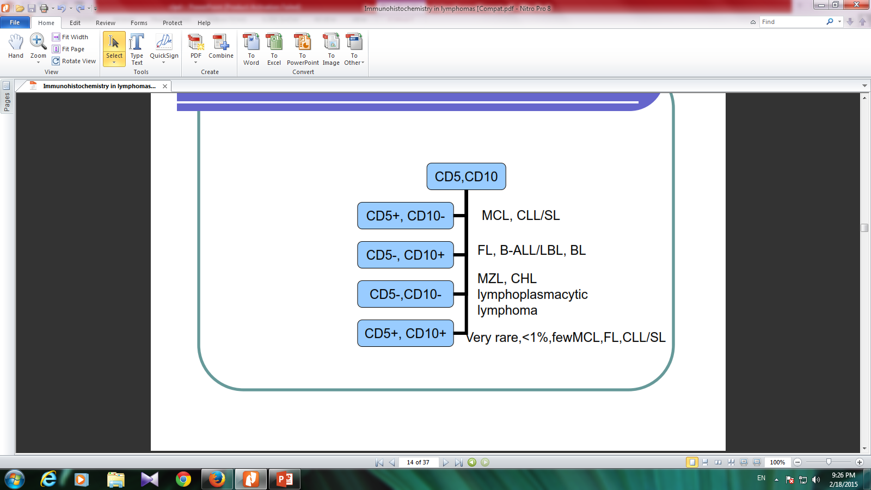

Slide 70
SLL/CLL
Clinical features
70
often asymptomatic
  Non specific : Easy fatigability, Weight loss, anorexia
  Generalized lymphadenopathy and hepatosplenomegaly in 50- 60%
  Hypogammaglobulinomia (>50%)
Presented in old ages (>50 years)

Slide 71
SLL/CLL
Most patients are leukemic at diagnosis
71

Slide 72
SLL/CLL
Morphology
Effacement of normal architecture by Sheets of small round lymphocytes and scattered ill - defined foci of larger actively dividing cells termed prolymphocytes.
72

Slide 73
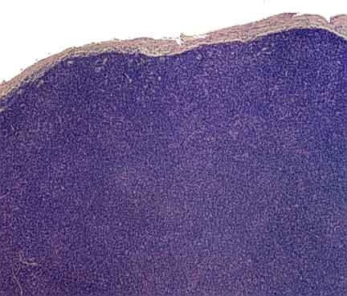
Small Lymphocytic Lymphoma
.
73

Slide 74
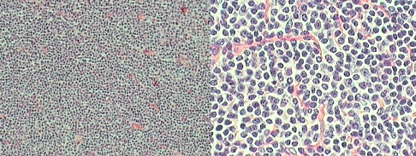
74

Slide 75
SLL/CLL Morphology:
  The foci of mitotically active cells are called,“ Proliferatin Centers” , their presence are pathognomonic for CLL/SLL
  Mitosis: rare
75

Slide 76
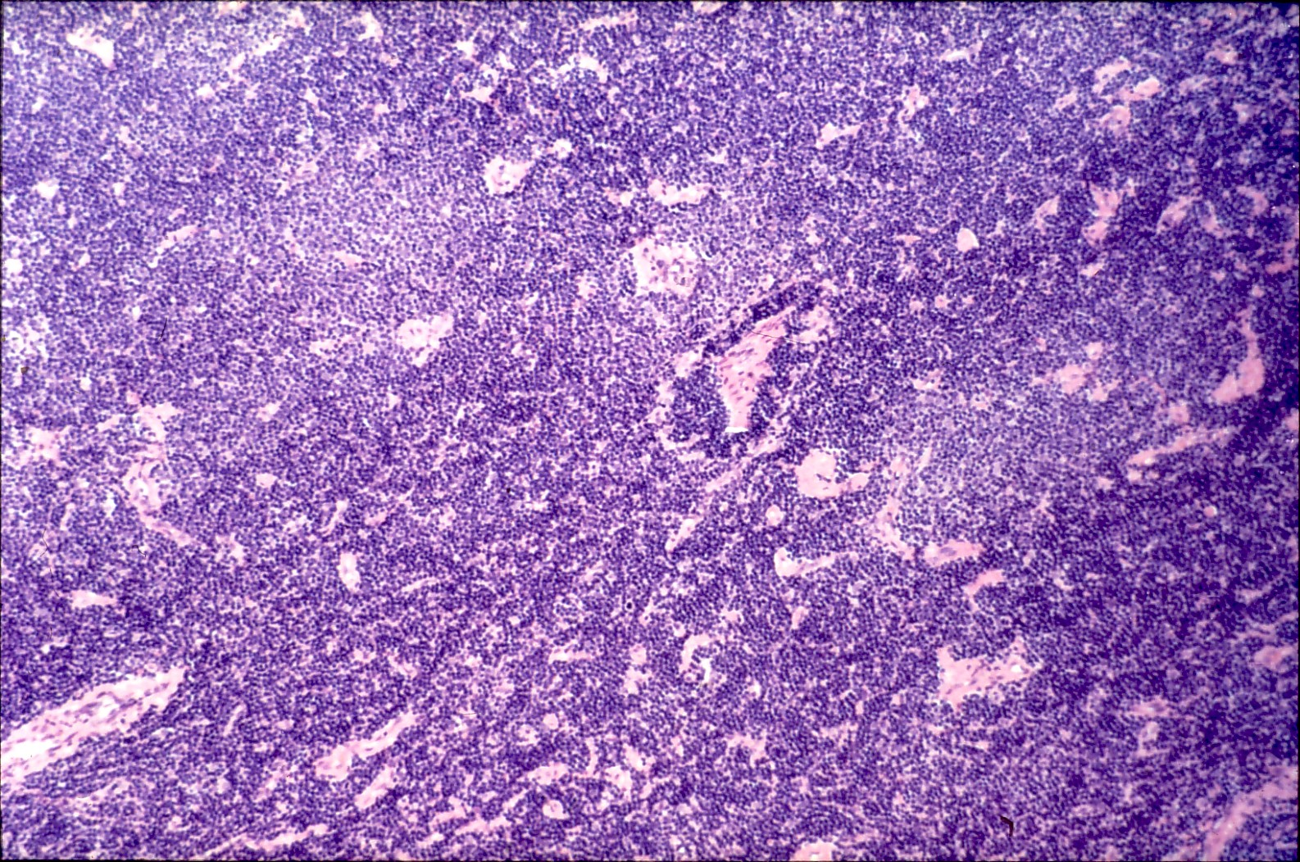
14

Slide 77
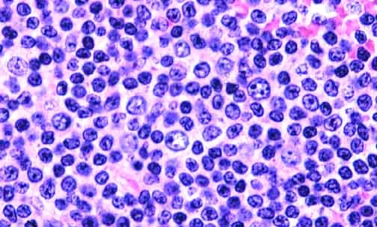
The larger cells, the prolymphocytes, are the characteristic cells of the proliferation center. In some small lymphocytic lymphomas they are scattered instead of collected into centers.

Slide 78
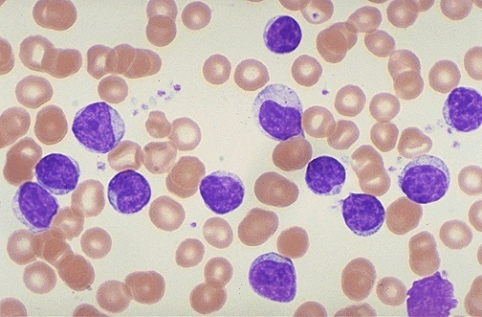
CLL

Slide 79
SLL/CLL
Transformation of SLL/CLL into “Prolymphocytic Leukemia” or “Diffuse Large B cell Lymphoma” (Richter's syndrome) is rare.
The median Survival is less than 1 Year
79

Slide 80
SLL/CLL Immunophonotype
Pan B markers CD20, CD19
CD5,CD23
80

Slide 81
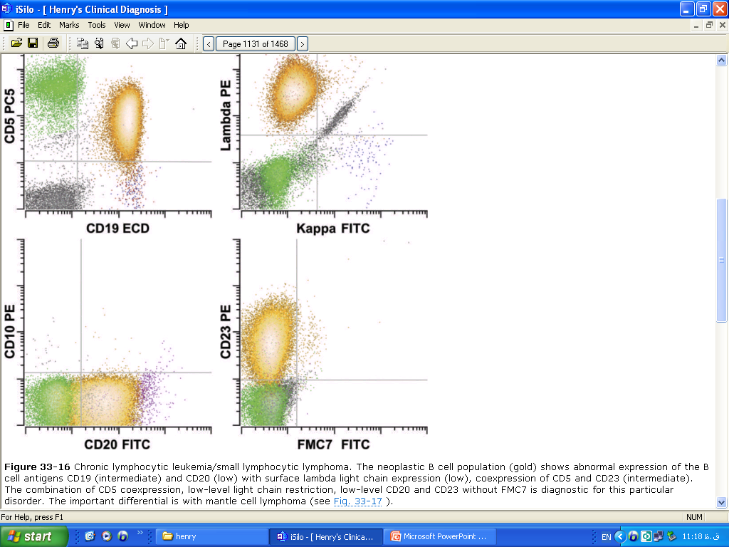

Slide 82
SLL/CLL Karyotype
trisomy 12, del 11q, del 13q
Poor prognosis
82

Slide 83
Hairy Cell Leukemia
Rare chronic lymphoproliferative disorder characterized by circulating B lymphocytes that display prominent cytoplasmic projections
Neoplastic B cells infiltrate the marrow(diffusely) and spleen(red pulp) in a characteristic way

Slide 84
2 to 3 percent of all adult leukemias
Predominantly a disease of middle-aged males with a median age at presentation of 52 years
M:F 4:1

Slide 85
Clinical Features
Pancytopenia
splenomegaly
circulating hairy cells
Infection from a wide variety of typical and opportunistic organisms

Slide 86
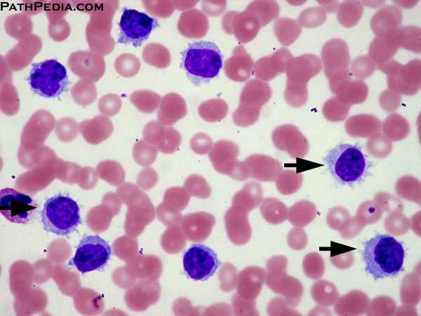
Laboratory Features
Anemia, thrombocytopenia, and leukopenia
Absolute neutropenia and monocytopenia(80%)
Hairy cells –
  Mononuclear cells with eccentric or central nuclei
  Nuclear morphology is variable: round, ovoid, reniform, or convoluted
  Reticular chromatin pattern
  Cytoplasm that is blue–gray, exhibiting thin cytoplasmic projections

Slide 87
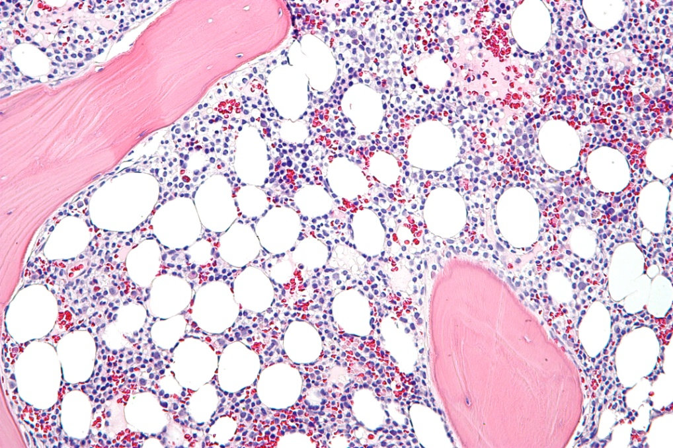
Marrow
Marrow involvement may be diffuse or focal
Hairy cells have monotonous round, oval, or spindle-spaced nuclei that are separated by abundant quantities of pale-staining cytoplasm in a fine fibrillar network
The separation of individual hairy cells is characteristic and referred to as the "fried-egg" appearance

Slide 88
Marked marrow reticulin fibrosis, the marrow frequently is difficult or impossible to aspirate
Hairy cells synthesize and assemble a fibronectin matrix that likely contributes to the marrow fibrosis characteristic of the disease

Slide 89
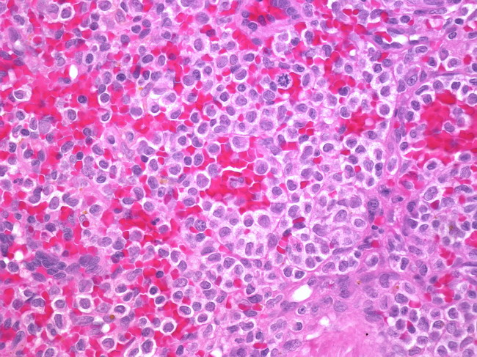
Spleen, Liver, and Lymph Nodes
The spleen usually is enlarged, with a median weight of 1300 g
On section, the spleen has a dark-red, smooth surface
On light microscopy, the hairy cells involve the splenic red pulp. Later, the white pulp atrophies and is replaced
Red cell lakes, which are blood-filled spaces lined by hairy cells that have disrupted the normal sinus architecture, are characteristic
These blood-filled spaces are referred to as pseudosinuses

Slide 90
Hepatic infiltration is both sinusoidal and portal
Lymph node involvement is marked by both sinusoidal and interstitial involvement

Slide 91
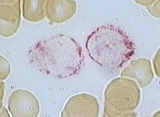
Cytochemistry
Strongly positive for TRAP
90 percent of cases
Weak to moderate TRAP staining may occur in other diseases, including prolymphocytic leukemia and lymphoma

Slide 92
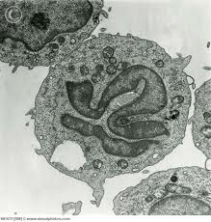
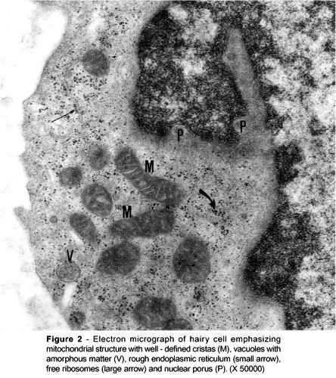
Electron Microscopy
Circumferential cytoplasmic projections
Ribosomal lamella complexes can be in 50 percent of patients

Slide 93
Immunophenotypic Profile
Mature B cells, express the pan B cell antigens CD19, CD20, and CD22, but not CD21, an antigen lost in the later stages of B cell development
Most distinctively, hairy cells express high levels of CD11c, CD22, CD25, and CD103

Slide 94
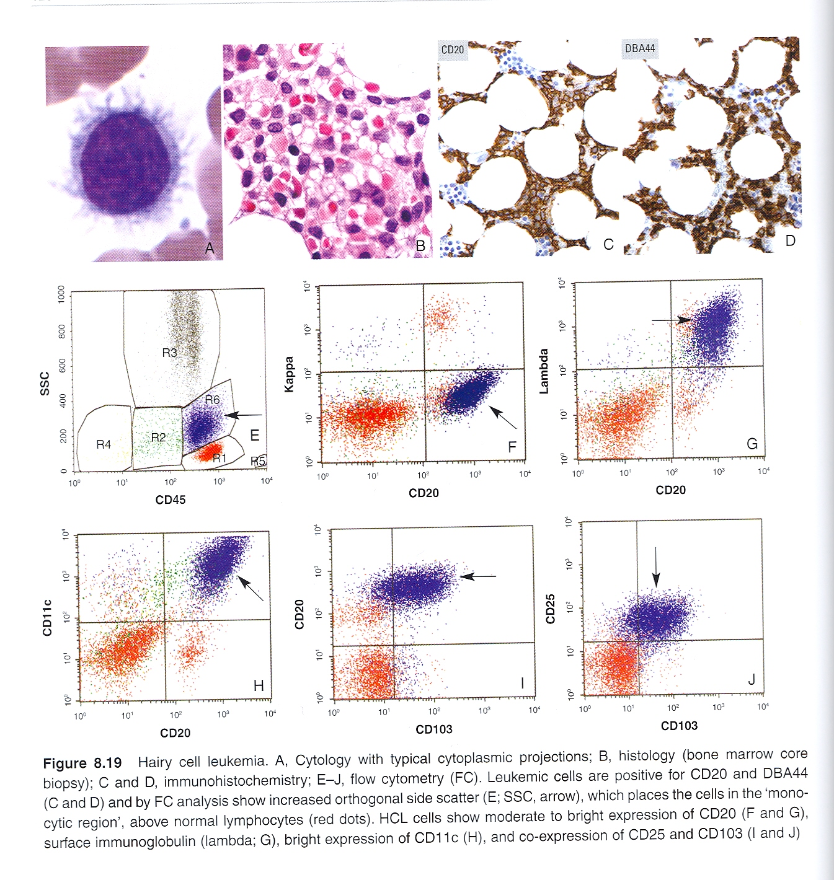

Slide 95
Annexin A1 most specific marker
Always compare with B cell antigen
Since it is also expressed in myeloid cells and a proportion of T cells

Slide 96
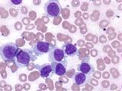
HCL vs HCL- v
Compare to HCL HCL-v have
Leucocytosis
Monocytosis
Cell
  Prominent nucleoli
  Blastic or convoluted nuclei
  Variant immunophenotype
    (absent CD25,annexin A1 and TRAP)

Slide 97
Course and Prognosis
With treatment survival rate 10 year more than 90%
Long term have increased risk of second malignancy

Slide 98


Splenic B cell marginal zone lymphoma
B cell neoplasm composed of small lymphocytes which surround and replace the splenic white pulp germinal centers
Peripheral blood ,bone marrow and splenic hilar lymph nodes are often involved
Lymphoma cell in peripheral blood as villus lymphocytes

Slide 99
Clinical features
Rare neoplasm ( <2% )
Patient present with splenomegaly ,autoimmune thrombocytopenia or anemia
Patient may be positive for hepatitis C

Slide 100

Morphology
Spleen – central zone of small round lymphocytes replace germinal centre and merge with peripheral zone of marginal zone cell
Red pulp – small nodules of larger cells and sheet of small lymphocytes

Slide 101
Bone marrow –nodular involvement (compare to diffuse involvement by hairy cell leukemia )
Peripheral blood –cells with short polar villi

Slide 102
Immunophenotype
Surface Ig M positive and mostly Ig D positive
CD20 and CD 79a positive
CD5,CD10,CD23,CD43,annexin A1 negative

Slide 103
Prognosis
Indolent
Response to chemotherapy is poor compare to other lymphoid leukemia

Slide 104
Mantle cell lymphoma
Rare type of lymphoma(3-10%)
Lymph node involvement is most common
Spleen and bone marrow can be involved
Peripheral blood 20-60% cases

Slide 105


Morphology
Monomorphic lymphoid population with nodular, diffuse, mantle or follicular growth pattern
Cells are medium size with irregular nuclear contours, resembling centrocytes
Blastoid, pleomorphic variant can be seen

Slide 106
Immnophenotype
Intense surface IgM/IgD
CD5,FMC-7,CD43 positive
CD10 and BCL 6 negative
CD23 negative or weakly positive
Cyclin D1 is positive

Slide 107


Slide 108
Prognosis
Median survival 3-5 years
Most of patient can not be cured

Slide 109
(CD5 +, CD10 -) CLL/SL or MCL?
Lack of proliferation centres
Irregular nuclear contours
Interspersed histiocytes
PAS positive vessels
Increased mitoses
CD23 and Cyclin D1

Slide 110
Follicular lymphoma
Most common lymphoma in USA and western Europe
Compose of follicular center cell(centrocytes/centroblasts) with partially follicular pattern

Slide 111
Clinical feature
Median age is 6 decade
Mainly involved lymph nodes,spleen,bone marrow, peripheral blood,waldeyer ring
Widespread soft tissue involvement can occur

Slide 112

Morphology
Lymph node – predominately follicular pattern, with closely packed follicles that efface normal architecture
Centocytes and blasts are randomly distributed
Tingible macrophages are absent

Slide 113

Bone marrow- characteristically paratrabecular region may spread to interstial area
Peripheral blood - Scant cytoplasm some cells show clefting

Slide 114
Immunophenotype
SIg+,
B cell marker CD19,CD20,CD22,CD79a positive
Follicular marker BCL6 and CD 10 positive
BCL2 positive(variable-higher grade less positive)
CD5 and CD 43 negative

Slide 115



Slide 116
CD5-CD10+ Follicular lymphoma?
Morphological features
CD10 &Bcl6 expressed in normal and neoplastic follicle centres
Presence of large numbers of CD10 &Bcl6 positive cells outside follicles suggests FL
Bcl2 distinguishes reactive follicles from FL

Slide 117


Slide 118
Prognosis
Extent of disease
International prognostic index for FL : Histological grade

Slide 119
B cell prolymphocytic leukemia
Affects – peripheral blood, bone marrow and spleen
Prolymphocytes must exceeds 55% of lymphoid cells
Median age 55-59 year
M:F ratio 1:1

Slide 120
Most patients with B symptoms
Massive splenomegaly
Absent lymphadenopathy
Rapidly raising lymphocyte count( >100x10 ⁹ )

Slide 121

Morphology
Peripheral smear
Majority cells are( usually 90% ) prolymphocytes
  Medium size
  Round nucleus
  Moderately condensed chromatin
  Prominent central nucleolus
  Small amount of faintly basophilic cytoplasm

Slide 122
Bone marrow
  Interstitial or
  Nodular involvement

Slide 123
D/D
  Blastic variant of MCL
  Splenic marginal zone lymphoma
  CLL with increase number of prolymphocytes

Slide 124
Immunophenotype
Surface IgM+/- IgD
B cell antigens –CD 19,CD20,CD22,CD79a
CD5- 20-30%
CD23- 10-20%

Slide 125
Prognosis
Respond poorly to therapies for CLL
Median survival 30-50 months

Slide 126
T cell and Nk cell lymphomas

Slide 127
Lymphoma | Median age | Peripheral blood | Cytopenia | BM | spleen | Lymph node | skin | prognosis
T cell prolymphocytic leukemia | 65 | Yes,prolymphocytes | Anemia ,thrombocytopenia | diffuse | Densered pulp | Diffuse,paracortical | Yes without epidermotrophism | Aggressive ,survival < 1 year
T cell large granular lymphocytic leukemia | 65 | Yes,large granular lymphocytes | Severe neutropenia+/-anemia | Intrasinusoidal,interstial | Red pulp invovment | no | no | indolant
Adult T cell leukemia /lymphoma | 50 (20-80) | Yes ,flower cell | Variable | yes | yes | Generalized | yes | Variable
Sezary syndrome | 70 | Yes,sezary cell | No | no | yes | yes | yes | Aggressive
CLPD of NK cells | 60 | Yes | rare | Intrasinusoidal,interstial | no | no | no | indolent
Agg. NK cell leukemia | 42 | Yes,variable morphology | common | Yes | Yes | uncommon | uncommon | fuminant

Slide 128
Mature T cell lymphomas

Slide 129
T cell prolymphocytic leukemia
Aggressive lymphoma
Proliferation of small to medium sized prolymphocytes in peripheral blood, bone marrow, lymph node, liver, spleen and skin

Slide 130
Clinical features
Rare lymphoma (<2%)
Median age 55 year
Patient present with hepatosplenomegaly and generalized lymphadenopathy
Skin is involved in 20% of cases
Lymphocyte count is usually >100x10⁹/l

Slide 131

Morphology
Peripheral blood
  Small to medium cell
  Non granular basophilic cytoplasm
  Round to oval or markedly irregular nuclei
  Visible nucleolus
    25% cases no nucleolus (small cell variant)
  Presence of cytoplasmic blebs or protrusions

Slide 132
Bone marrow
  Diffuse involvement
Cutaneous
  Perivascular or diffuse dermal infiltration without
  epidermotrophism
Spleen
  Dense red pulp infiltration
Lymph node
  Paracortical infiltration

Slide 133
Immunophenotype
Positive for CD2, CD3, CD7
Negative for TdT and CD1a
CD4+ , CD8- : 60%
CD4 -, CD8 +: 25%
CD4 -, CD8 +: 15%

Slide 134
Prognosis
Aggressive
Median survival less than 1 year

Slide 135
T cell large granular lymphocytic leukemia
Heterogonous disorder
Persistent (more than 6 months) lymphocytosis (2-20x10⁹/l)
Large granular lymphocytes

Slide 136
Clinical feature
2-3% of lymphoma
M:F =1:1
Age range 45-75 year
Involve PB, BM, liver, spleen.
Lymphadenopathy is very rare

Slide 137
Splenomegaly main physical finding
Varying degree of cytopenia
Mainly severe neutropenia
Autoimmune diseases common

Slide 138

Morphology
Peripheral blood
  LGL with
    Moderate to abundant cytoplasm
    Fine or coarse azurophillic granules
Bone marrow –mainly interstitial/sinusoidal involvement
Spleen –red pulp cords and sinusoids involvement

Slide 139
Immunophenotype
Positive for CD3,CD8 and T cell receptor αβ
May be negative for CD5 and CD7

Slide 140
Prognosis
Indolent course and non progressive
Really neoplasm of uncertain significance or leukemia?

Slide 141
Chronic lymphoproliferative disorders of NK cells
Heterogonous disorder
Persistent (more than 6 months) lymphocytosis (2-20x10⁹/l)
NK cells proliferation
Without identifiable cause

Slide 142
Clinical features
Median age 60 year
Majority are asymptomatic
Some with systemic symptoms and/or cytopenia

Slide 143

Morphology
NK cells are
  Intermediate size
  Round nucleus
  Condensed chromatin
  Moderate amount of slightly basophillic cytoplasm
  Fine or coarse azurophillic granules
Bone marrow
  Intrasinusoidal and inerstitial infiltration

Slide 144
Immunophenotype
Surface CD 3 negative
CD 16 positive
CD56 weak positive
Cytotoxic markers like TIA1,granzyme B and granzyme M positive
CD5 CD7 may be lost
CD5 and CD8 may be aberrantly expressed

Slide 145
Prognosis
Indolent clinical course
Patient may die because of cytopenia

Slide 146
Aggressive NK-cell leukemia
Systemic neoplastic proliferation of NK cells
Almost associated with EB virus

Slide 147
Clinical feature
Rare form of leukemia
Middle age
Peripheral blood, bone marrow liver and spleen involvement
Patient present with fever ,constitutional symptoms and leukemic blood picture
Varying degree of cytopenia

Slide 148

Morphology
Range of appearance from cells indistinguishable from large granular lymphocytes to cells with atypical nuclei featuring enlargement , irregular folding, open chromatin or distinct nucleoli
Ample amount of basophillic cytoplasm containing fine or azurophillic granules

Slide 149
Bone marrow shows massive, focal or subtle infiltration by the neoplastic cells intermingled with histiocytes and hematophagocytosis

Slide 150
Immunophenotype
Surface CD3 negative
Cells positive are CD2,CD56 and cytotoxic molecules

Slide 151
Prognosis
Fulminant course
Complicated by multiorgan failure , coagulopathy and hemophagocytic syndrome
Median survival less than 2 months

Slide 152
Adult T cell leukemia/lymphoma
Peripheral T cell neoplasm
Highly pleomorphic lymphocytes
Caused by human T cell leukemia virus type 1

Slide 153
Clinical features
Latent course
Cumulative risk of ATLL is 2.5%
Involve
  Lymph nodes
  Peripheral blood
  Other
    Bone marrow
    Skin (most common extralymphatic site)
    Spleen,lung ,CNS,GI tract

Slide 154
Clinical variants-acute, lymphomatous , chronic, smoldering
Acute (most common)-like leukemic phase
  Increase WBC count,skin rash, generalized lymphadenopathy,hypercalcemia, lytic bone lesion
Lymphomatous variant
  Prominent lymphadenopathy without PB involvment

Slide 155
Chronic variant
  Exfoliative skin rash, no numerous atypical lymphocytes
Smoldering variant
  WBC count normal with more than 5% atypical cell

Slide 156

Morphology
Broad spectrum of cytological features
Peripheral blood
  Polylobated appearance –flower cells
    Deeply basophillic cytoplsam
Lymph node –Hodgkin lymphoma like picture
Dermal –like mycosis fungoides

Slide 157
Immunophenotype
CD2,CD3,CD5 positive
CD7 negative
CD25 positive in all cases

Slide 158
Prognosis
Clinical subtypes
Age
Performance status
Calcium level
Serum LDH level

Slide 159
Sezary syndrome
Triad of
  Erythroderma
  Generalized lymphadenopathy
  Clonally related neoplastic T cells with cerebriform nuclei in skin ,lymph nodes and peripheral blood
In addition(one or more criteria)
  Absolte sezary cell count at least 1000 cells per mm3
  CD4/CD8 ratio more than 10
  Loss of one or more T cell antigen

Slide 160



Slide 161
Clinical feature
Rare < 5% of all cutaneous T cell lymphoma.
Age more than 60 year
Generalized disease
All visceral organ involved except bone marrow
Patient present with erythroderma and generalized lymphadenopathy

Slide 162
Morphology
Morphological feature similar to mycosis fungoides
Along with infiltration of lymph node and peripheral blood

Slide 163
Immunophenotype
CD2 CD3 CD5 positive
Lack CD7
Skin homing receptor CCR4 positive

Slide 164
Prognosis
Aggressive disease
Overall survival at 5 year is 10-20 %

Slide 165
TREATMENT
Depending on the nosological diagnosis and the stage of the disease, lymphoma treatment is based on the use of polychemotherapy and radiotherapy programs. As cytostatic agents, cyclophosphamide, rubomycin, vincristine, prednisolone (CHOP program) and some other drugs are most often used.
In the absence of leukemia, there is a good opportunity for intensive chemotherapy followed by transplantation of autologous bone marrow harvested from the patient before intensive treatment. In addition to autotransplantation, under appropriate conditions, allogeneic bone marrow transplantation is used to treat lymphomas.

Slide 166
Thank you

